Slide 1
E-R Model

Slide 2
Entity-Relationship (E/R) Model
Widely used conceptual level data model-proposed by Peter P Chen in 1970
Data model to describe the database system at the requirements collection stage
Concepts available in the model
•entities and attributes of entities.
•relationships between entities.
•diagrammatic notation

Slide 3
Entities
Entity-a thing (animate or inanimate) of independent physical or conceptual existence and distinguishable. In the University database context, an individual student, faculty member, a class room, a course are entities.
Entity Set or Entity Type-Collection of entities all having the same properties.
Student entity set –collection of all student entities.
Course entity set –collection of all course entities

Slide 4
Attributes
Each entity is described by a set of attributes/properties.
Student entity
StudName–name of the student.
RollNumber–the roll number of the student.
Sex–the gender of the student etc.
All entities in an Entity set/type have the same set of attributes.

Slide 5
Types of Attributes
Simple Attributes-having atomic or indivisible values.
example: Dept–a string
PhoneNumber–an eight digit number
•Composite Attribute-having several components in the value.
example: Qualification with components(DegreeName, Year, UniversityName)
•Derived Attributes-Attribute value is dependent on some other attribute.
example:Agedepends on DateOfBirth. So age is a derived attribute.

Slide 6
Types of Attributes
Single-valued
having only one value rather than a set of values.
for instance, PlaceOfBirth–single string value.
• Multi-valued
having a set of values rather than a single value.
for instance, CoursesEnrolled attribute for student
EmailAddress attribute for student
PreviousDegreeattribute for student.
•Attributes can be: simple single-valued, simple multi-valued,􀂃composite single-valued or composite multi-valued.

Slide 7
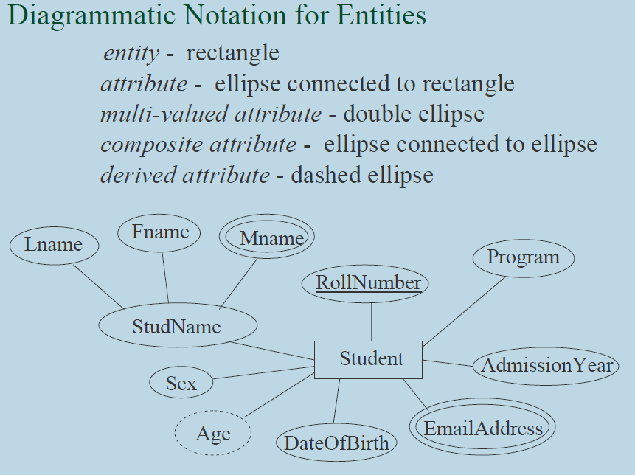

Slide 8
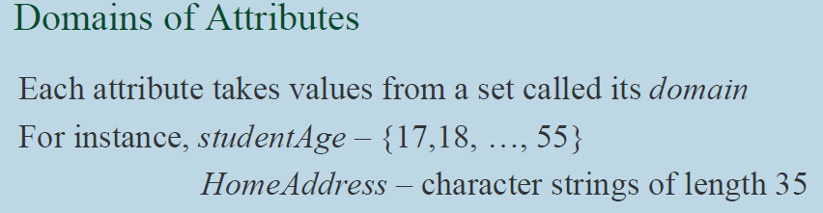

Slide 9
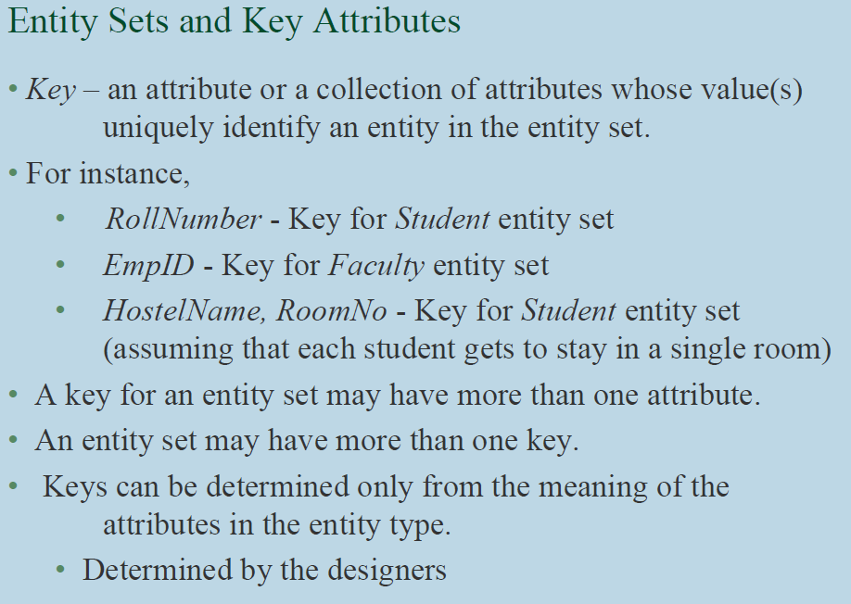

Slide 10
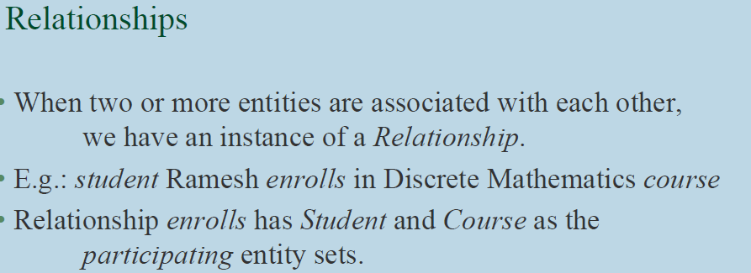

Slide 11
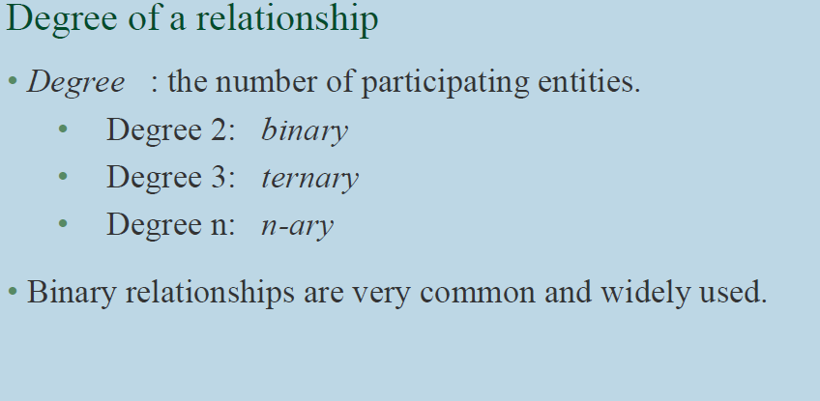

Slide 12
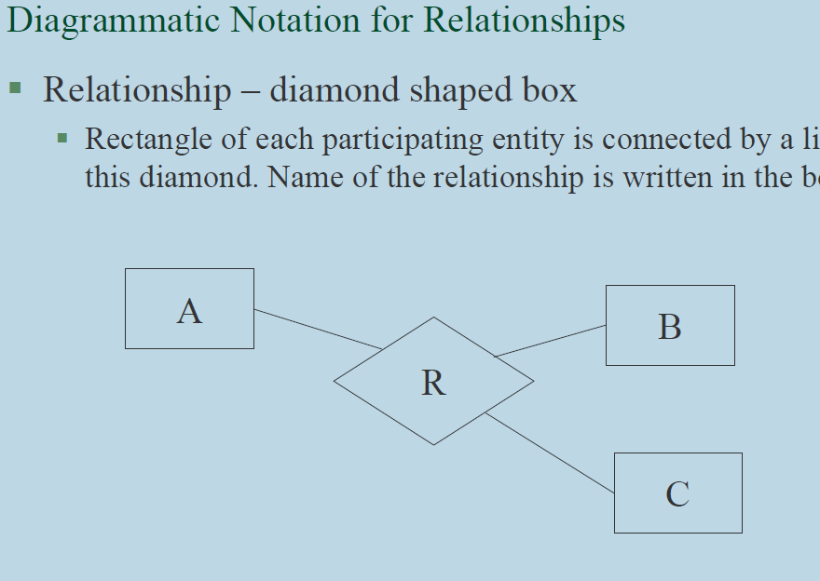

Slide 13
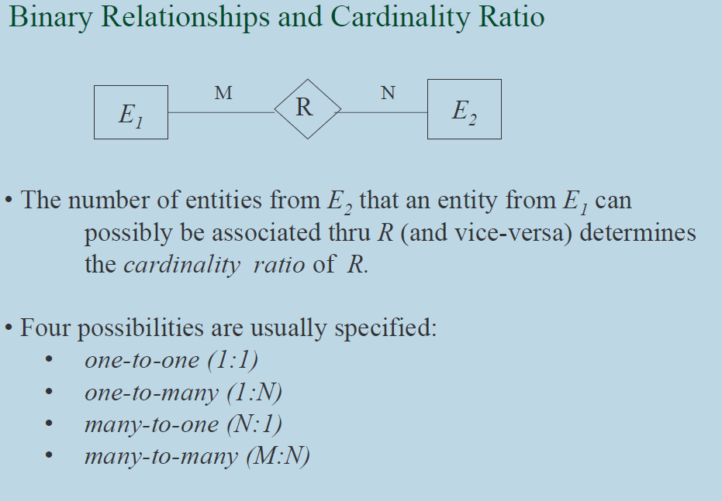

Slide 14
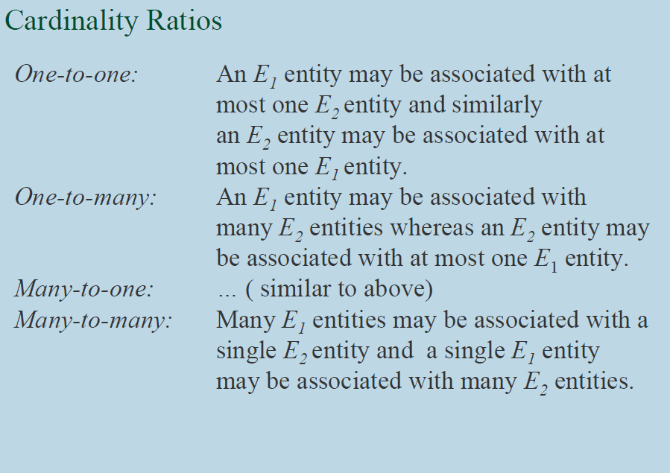

Slide 15
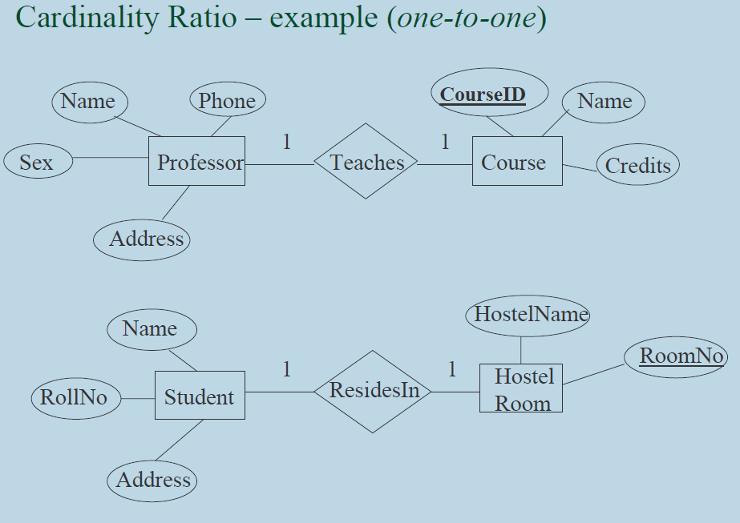

Slide 16
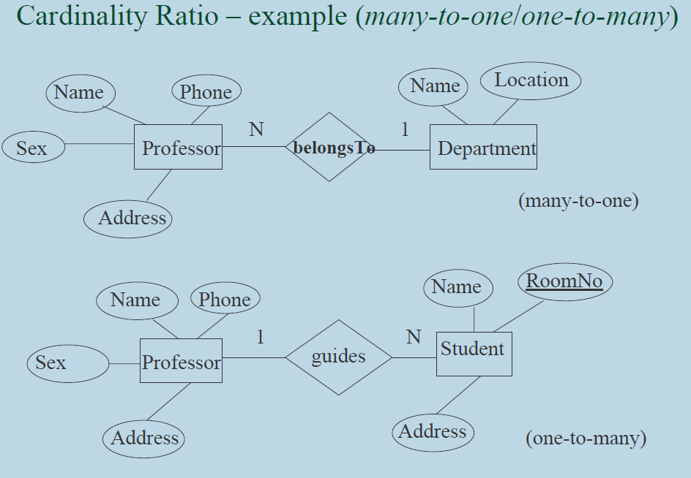

Slide 17
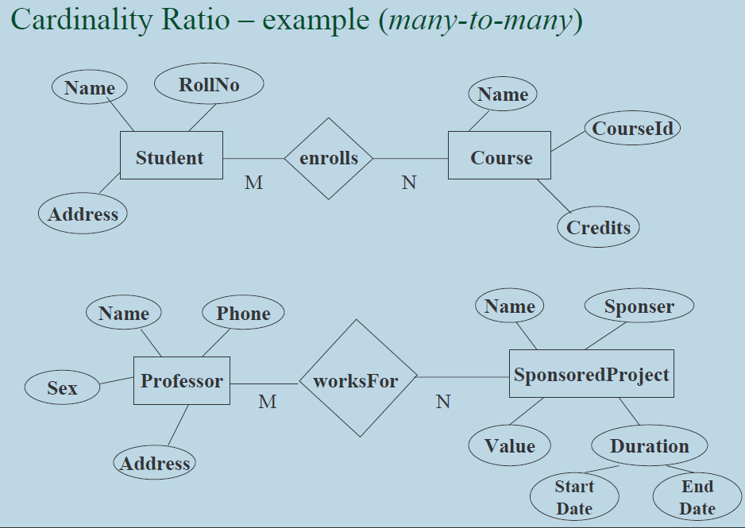

Slide 18
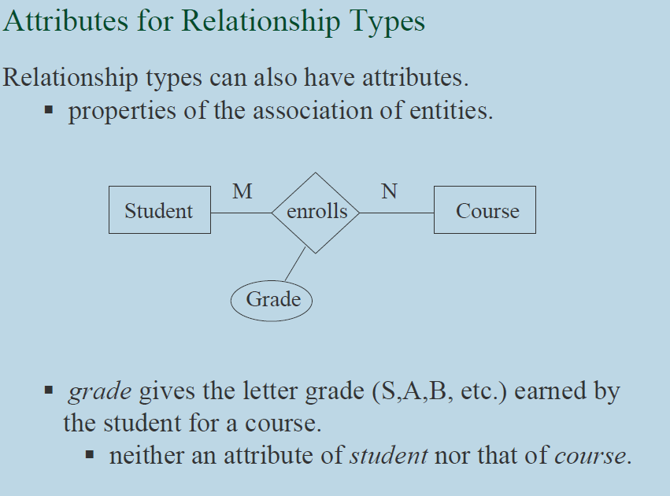

Slide 19
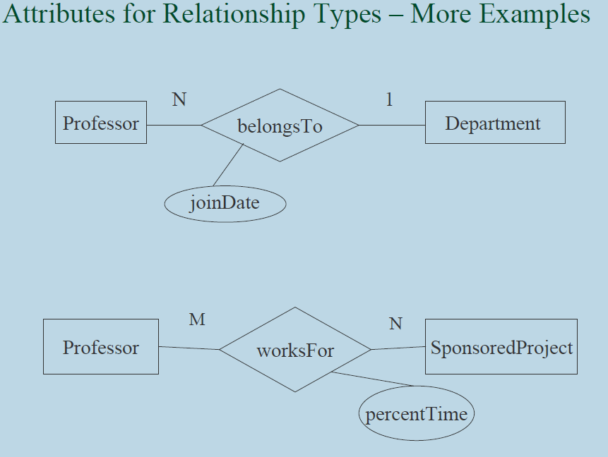

Slide 20
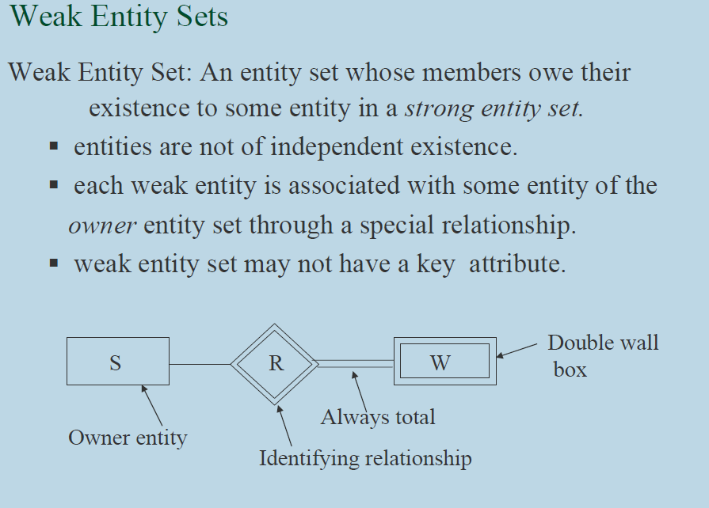

Slide 21
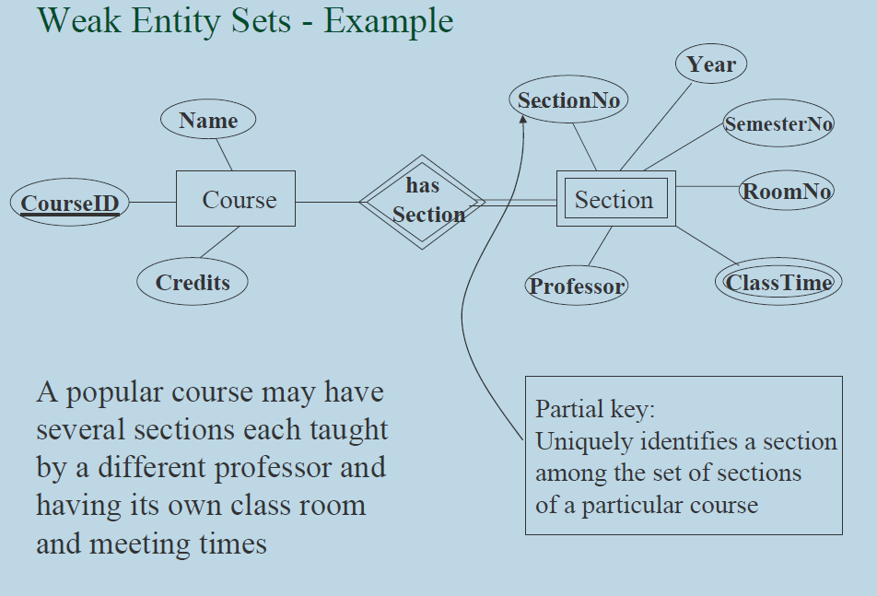

Slide 22
Partial Key
An attribute is a Partial Key if a Key from a related entity type must be used in conjunction with the attribute in question to uniquely identify instances of a corresponding entity set.
For example, suppose "Course Number" is an attribute of the Course entity type in our design for a University database. Suppose Course Number alone cannot uniquely identify courses. Rather, to identify a course we must include the Department Number attribute as well.

Slide 23
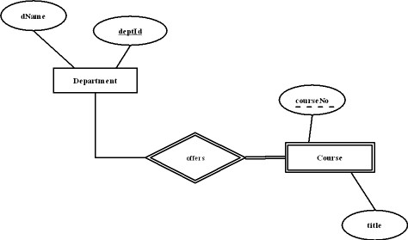

Slide 24
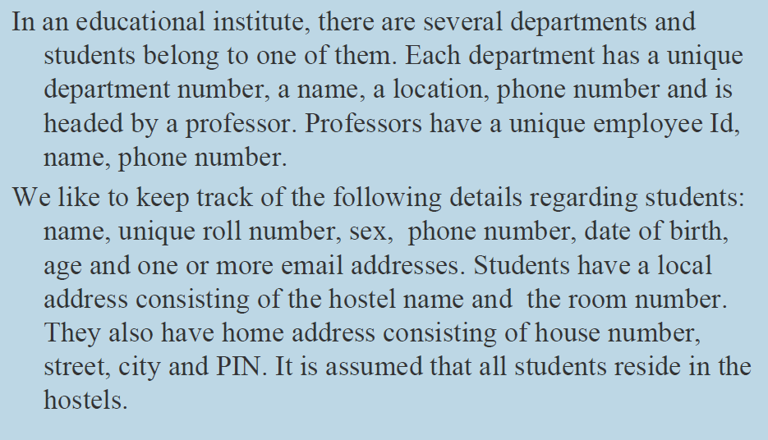

Slide 25
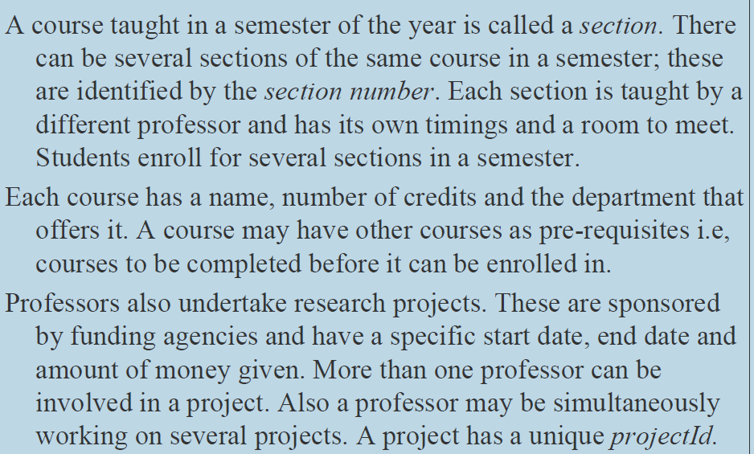

Slide 26
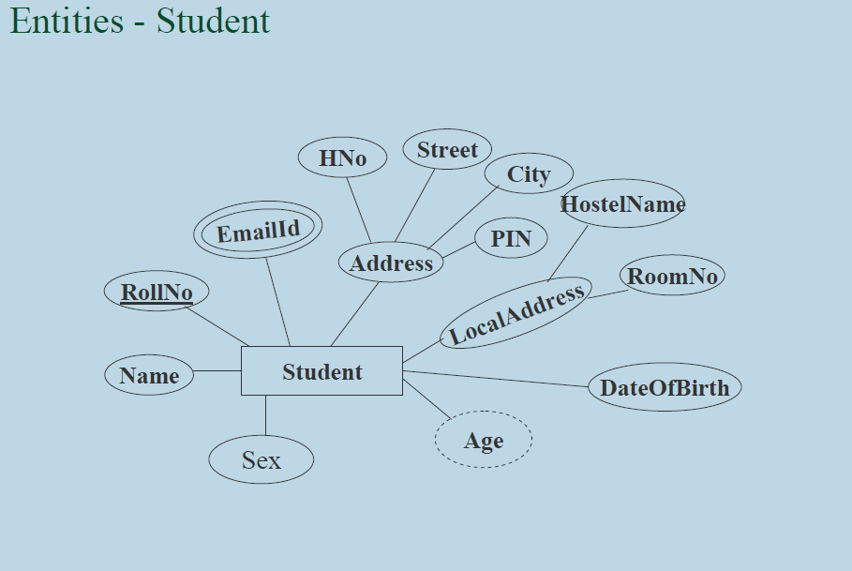

Slide 27
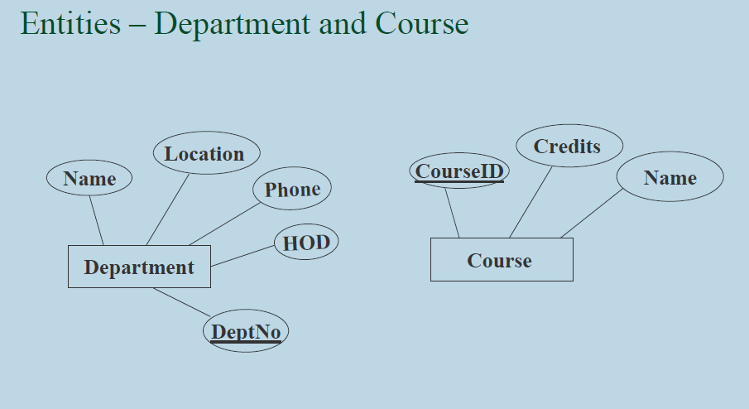

Slide 28
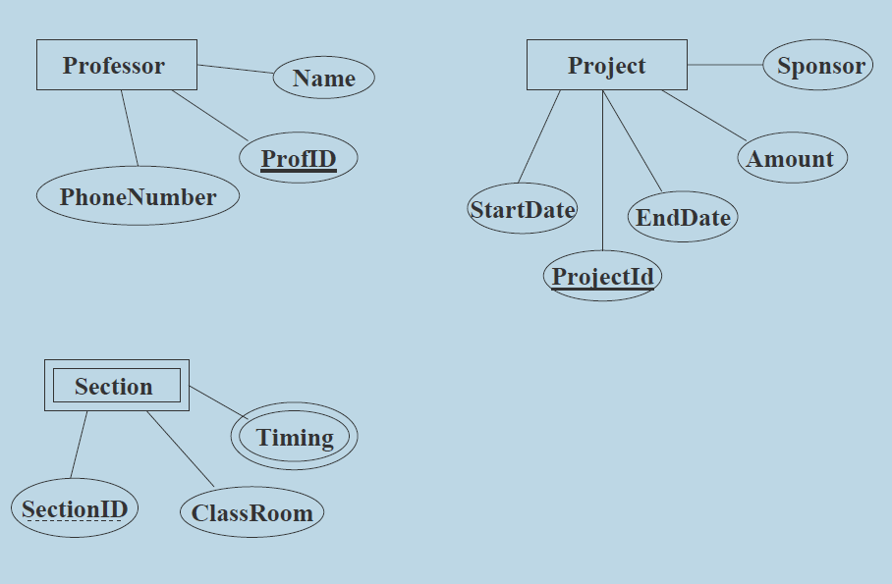

Slide 29
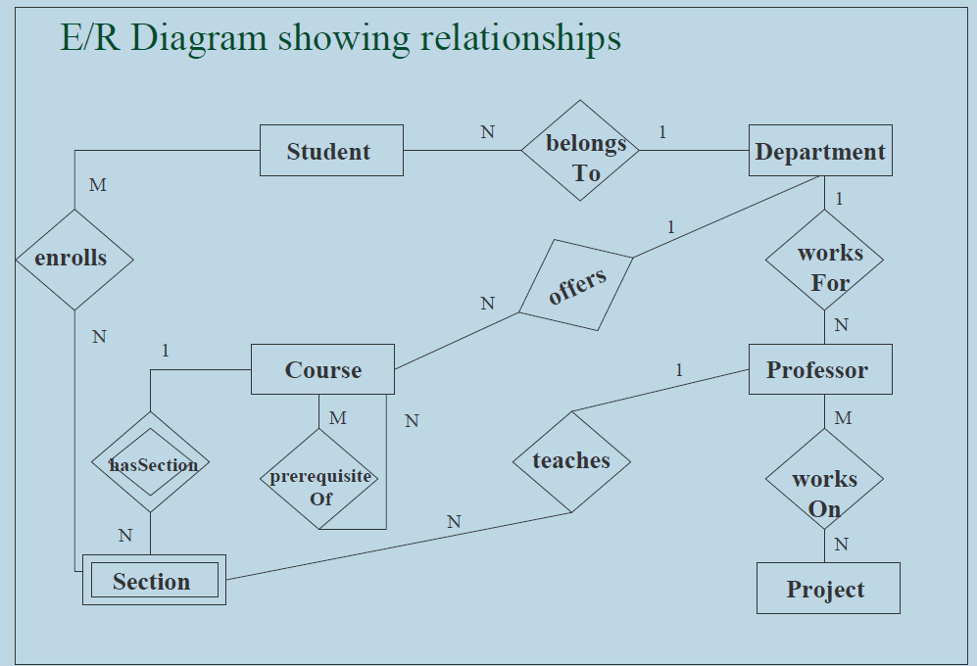

Slide 30
Problems
Question 1 : Suppose you are given the following requirements for a simple database for the National Hockey League (NHL):
the NHL has many teams,
each team has a name, a city, a coach, a captain, and a set of
players,
each player belongs to only one team,
each player has a name, a position (such as left wing or goalie), a skill level, and a set of injury records,
a team captain is also a player,
a game is played between two teams (referred to as host_team and guest_team) and has a date (such as May 11th, 1999) and a score (such as 4 to 2).

Slide 31
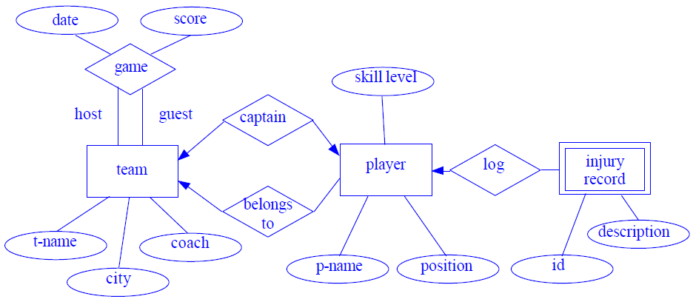

Slide 32
Design an E-R diagram for keeping track of the exploits of your favorite sports team. You should store the matches played, the scores in each match, the players in each match and individual player statistics for each match. Summary statistics should be modeled as derived attributes.

Slide 33
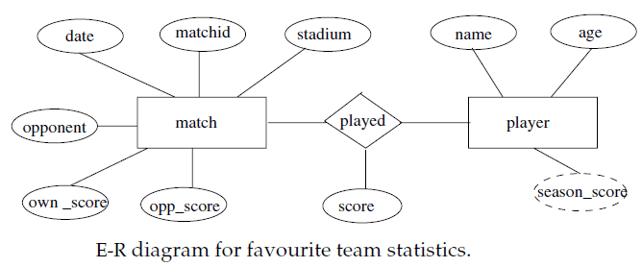

Slide 34
Construct an ER Diagram for Company having following details :
Company organized into DEPARTMENT. Each department has unique
name and a particular employee who manages the department. Start date for the manager is recorded. Department may have several locations.
A department controls a number of PROJECT. Projects have a unique
name, number and a single location.
Company’s EMPLOYEE name, ssno, address, salary, sex and birth date
are recorded. An employee is assigned to one department, but may work for several projects (not necessarily controlled by her dept). Number of hours/week an employee works on each project is recorded; The immediate supervisor for the employee.
Employee’s DEPENDENT are tracked for health insurance purposes (dependent name, birthdate, relationship to employee).

Slide 35
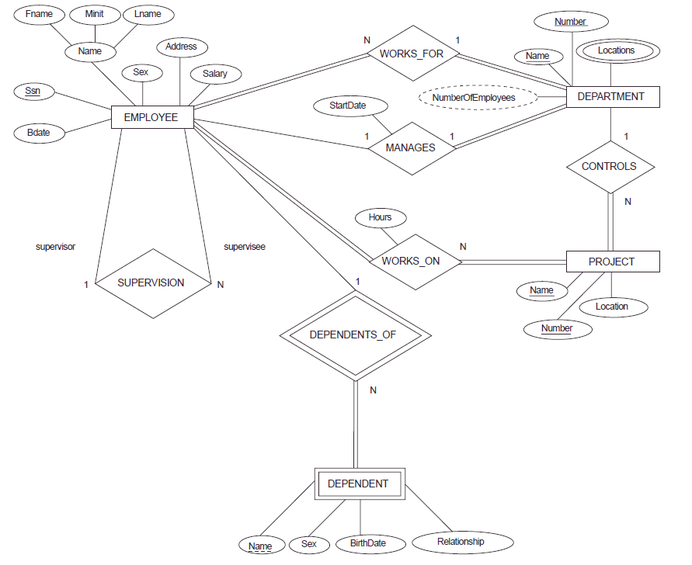

Slide 36
Total Participation − Each entity is involved in the relationship. Total participation is represented by double lines.
Partial participation − Not all entities are involved in the relationship. Partial participation is represented by single lines.

Slide 37
A superkey is a combination of columns that uniquely identifies any row within a relational database management system (RDBMS) table.
In the relational model of databases, a candidate key of a relation is a minimal super key for that relation.
Each table may have one or more candidate keys, but one candidate key is special, and it is called the primary key.
A composite key is a combination of two or more columns in a table that can be used to uniquely identify each row in the table when the columns are combined uniqueness is guaranteed, but when it taken individually it does not guarantee uniqueness.
In the context of relational databases, a foreign key is a field (or collection of fields) in one table that uniquely identifies a row of another table. In simpler words, the foreign key is defined in a second table, but it refers to the primary key in the first table.

